Slide 1
Introduction to Differential Equations - Lecture 13
Fei Qi
Email: fei.qi@du.edu
Office Hour: TBA
Website: https://feiqimath.github.io

Slide 2
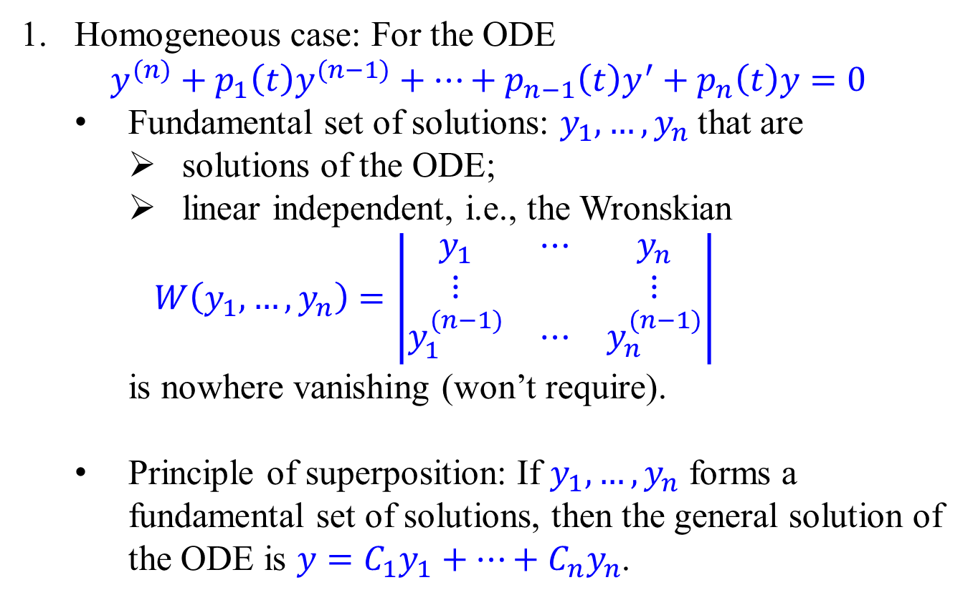
Higher order linear ODE – General theory
Homogeneous case: For the ODE $y^{(n)}+p_{1}\left(t\right)y^{(n−1)}+⋯+p_{n−1}\left(t\right)y^{′}+p_{n}\left(t\right)y=0$
Fundamental set of solutions: $y_{1},…, y_{n}$ that are
solutions of the ODE;
linear independent, i.e., the Wronskian
$$W\left(y_{1},…, y_{n}\right)=\left|\begin{matrix}y_{1} & ⋯ & y_{n} \\ ⋮ & & ⋮ \\ y_{1}^{(n−1)} & ⋯ & y_{n}^{(n−1)}\end{matrix}\right|$$
is nowhere vanishing (won’t require).
Principle of superposition: If $y_{1},…, y_{n}$ forms a fundamental set of solutions, then the general solution of the ODE is $y=C_{1}y_{1}+⋯+C_{n}y_{n}$.

Slide 3
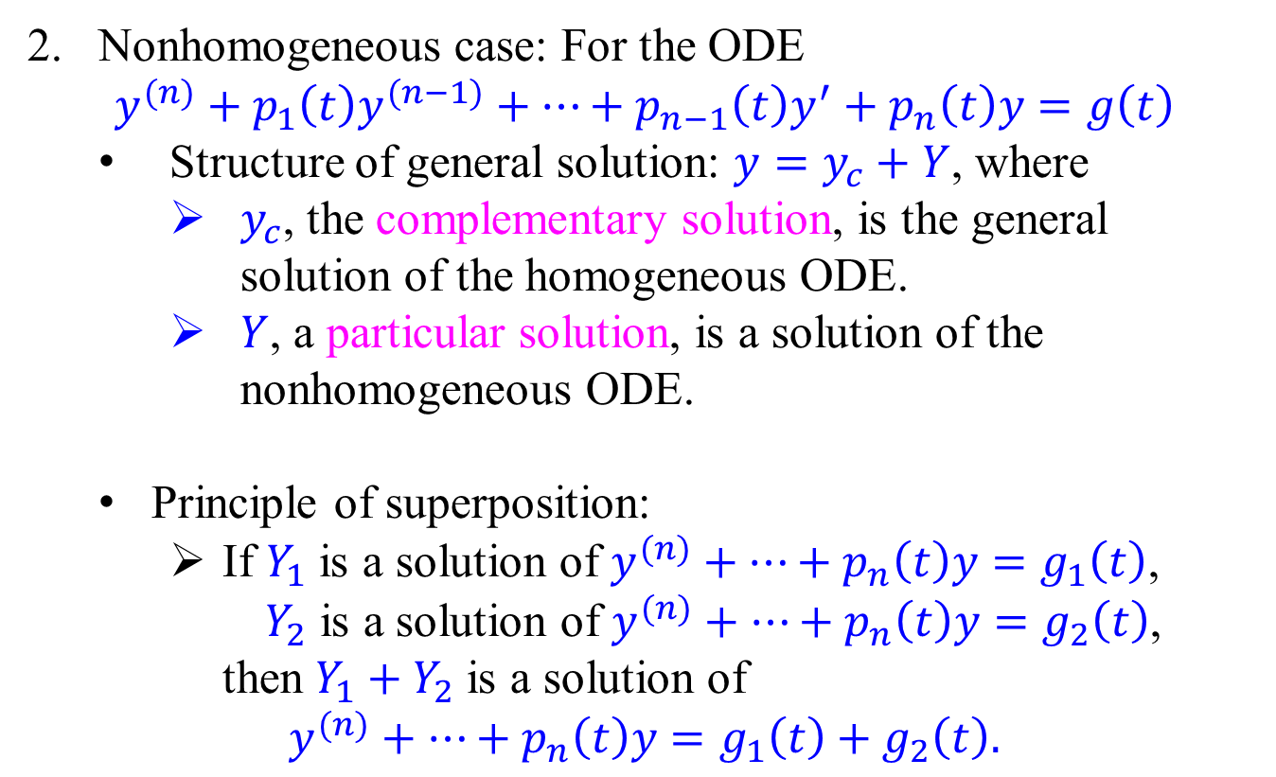
Higher order linear ODE – General theory
Nonhomogeneous case: For the ODE $y^{(n)}+p_{1}\left(t\right)y^{(n−1)}+⋯+p_{n−1}\left(t\right)y^{′}+p_{n}\left(t\right)y=g\left(t\right)$
Structure of general solution: $y=y_{c}+Y$, where
$y_{c}$, the complementary solution, is the general solution of the homogeneous ODE.
$Y$, a particular solution, is a solution of the nonhomogeneous ODE.
Principle of superposition:
If $Y_{1}$ is a solution of $y^{(n)}+⋯+p_{n}\left(t\right)y=g_{1}\left(t\right)$, $Y_{2}$ is a solution of $y^{(n)}+⋯+p_{n}\left(t\right)y=g_{2}\left(t\right)$, then $Y_{1}+Y_{2}$ is a solution of
$$y^{(n)}+⋯+p_{n}\left(t\right)y=g_{1}\left(t\right)+g_{2}\left(t\right).$$

Slide 4
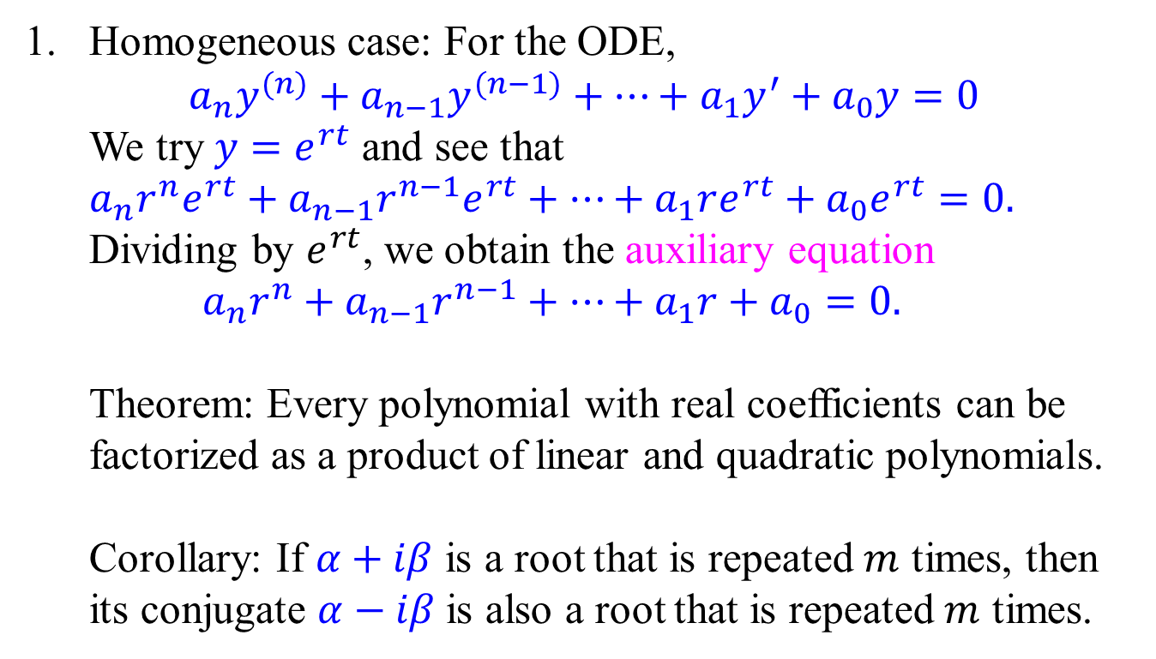
Higher order linear ODE with Const. Coeff.
Homogeneous case: For the ODE, $a_{n}y^{(n)}+a_{n−1}y^{(n−1)}+⋯+a_{1}y^{′}+a_{0}y=0$
We try $y=e^{rt}$ and see that $$a_{n}r^{n}e^{rt}+a_{n−1}r^{n−1}e^{rt}+⋯+a_{1}re^{rt}+a_{0}e^{rt}=0.$$ Dividing by $e^{rt}$, we obtain the auxiliary equation $$a_{n}r^{n}+a_{n−1}r^{n−1}+⋯+a_{1}r+a_{0}=0.$$
Theorem: Every polynomial with real coefficients can be factorized as a product of linear and quadratic polynomials.
Corollary: If $α+iβ$ is a root that is repeated $m$ times, then its conjugate $α−iβ$ is also a root that is repeated $m$ times.

Slide 5
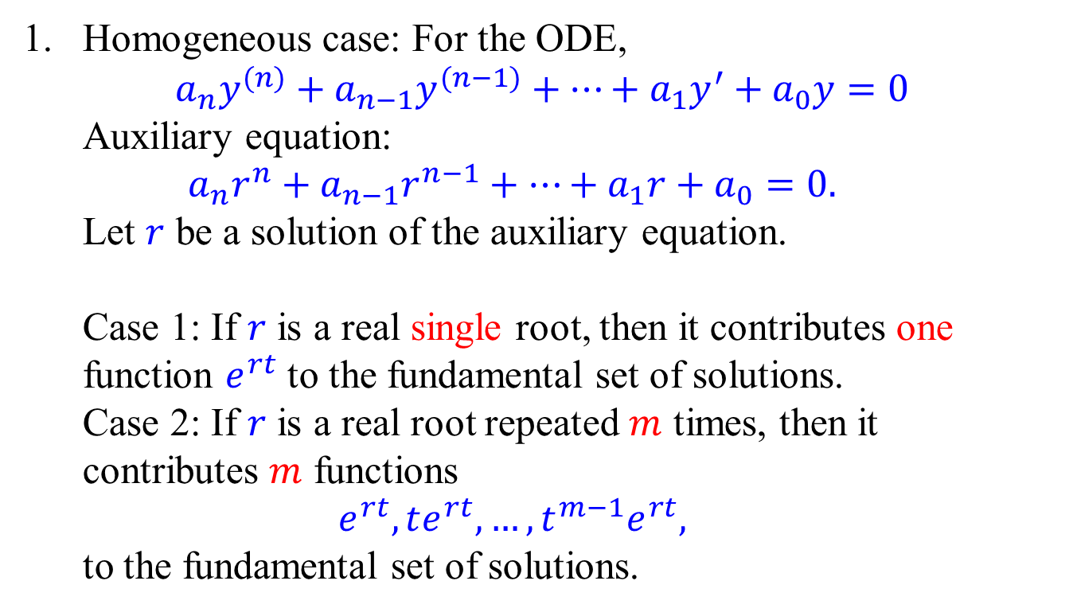
Higher order linear ODE with Const. Coeff.
Homogeneous case: For the ODE, $a_{n}y^{(n)}+a_{n−1}y^{(n−1)}+⋯+a_{1}y^{′}+a_{0}y=0$
Auxiliary equation: $$a_{n}r^{n}+a_{n−1}r^{n−1}+⋯+a_{1}r+a_{0}=0.$$
Let $r$ be a solution of the auxiliary equation.
Case 1: If $r$ is a real single root, then it contributes one function $e^{rt}$ to the fundamental set of solutions.
Case 2: If $r$ is a real root repeated $m$ times, then it contributes $m$ functions
$$e^{rt}, te^{rt}, …, t^{m−1}e^{rt},$$
to the fundamental set of solutions.

Slide 6
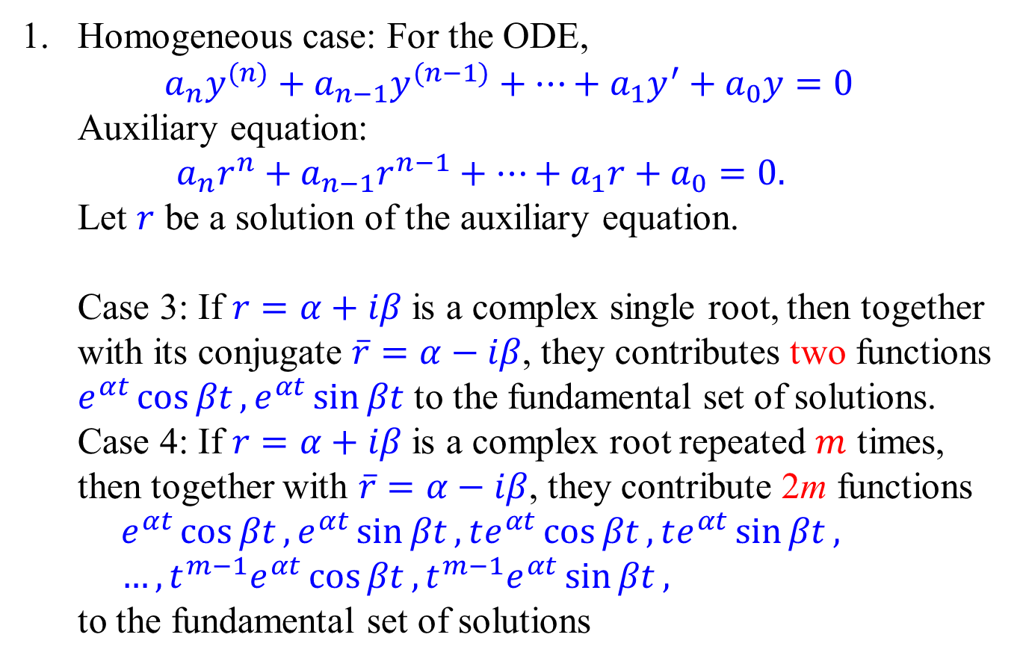
Higher order linear ODE with Const. Coeff.
Homogeneous case: For the ODE, $a_{n}y^{(n)}+a_{n−1}y^{(n−1)}+⋯+a_{1}y^{′}+a_{0}y=0$
Auxiliary equation: $$a_{n}r^{n}+a_{n−1}r^{n−1}+⋯+a_{1}r+a_{0}=0.$$
Let $r$ be a solution of the auxiliary equation.
Case 3: If $r=α+iβ$ is a complex single root, then together with its conjugate $\overline{r}=α−iβ$, they contributes two functions $e^{αt}\cos{βt},e^{αt}\sin{βt}$ to the fundamental set of solutions.
Case 4: If $r=α+iβ$ is a complex root repeated $m$ times, then together with $\overline{r}=α−iβ$, they contribute 2m functions $$e^{αt}\cos{βt},e^{αt}\sin{βt},te^{αt}\cos{βt},te^{αt}\sin{βt}, \\ …,t^{m−1}e^{αt}\cos{βt},t^{m−1}e^{αt}\sin{βt},$$
to the fundamental set of solutions

Slide 7
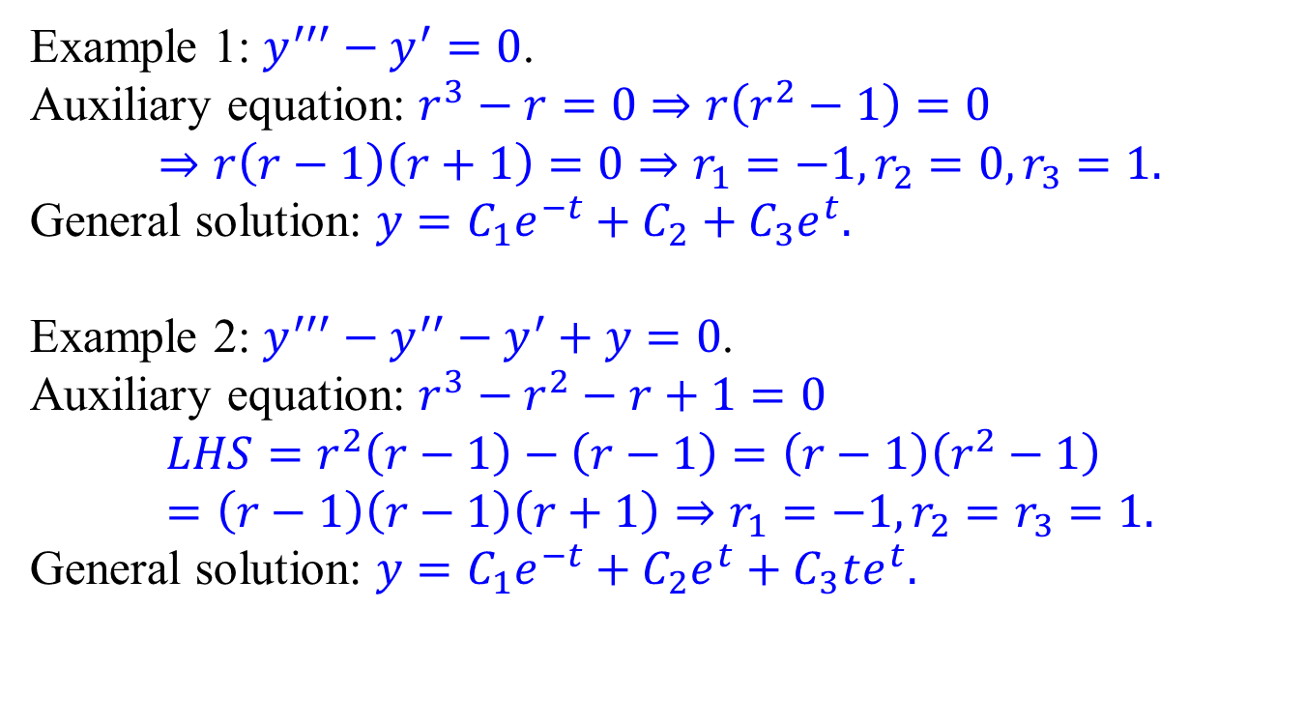
Examples:
Example 1: $y^{′′′}−y^{′}=0$.
Auxiliary equation: $r^{3}−r=0⇒r\left(r^{2}−1\right)=0$ $$⇒r\left(r−1\right)\left(r+1\right)=0⇒r_{1}=−1,r_{2}=0,r_{3}=1.$$
General solution: $y=C_{1}e^{−t}+C_{2}+C_{3}e^{t}.$
Example 2: $y^{′′′}−y^{′′}−y^{′}+y=0$.
Auxiliary equation: $r^{3}−r^{2}−r+1=0$ $$LHS=r^{2}\left(r−1\right)−\left(r−1\right)=\left(r−1\right)\left(r^{2}−1\right) \\ =\left(r−1\right)\left(r−1\right)\left(r+1\right)⇒r_{1}=−1,r_{2}=r_{3}=1.$$
General solution: $y=C_{1}e^{−t}+C_{2}e^{t}+C_{3}te^{t}.$

Slide 8
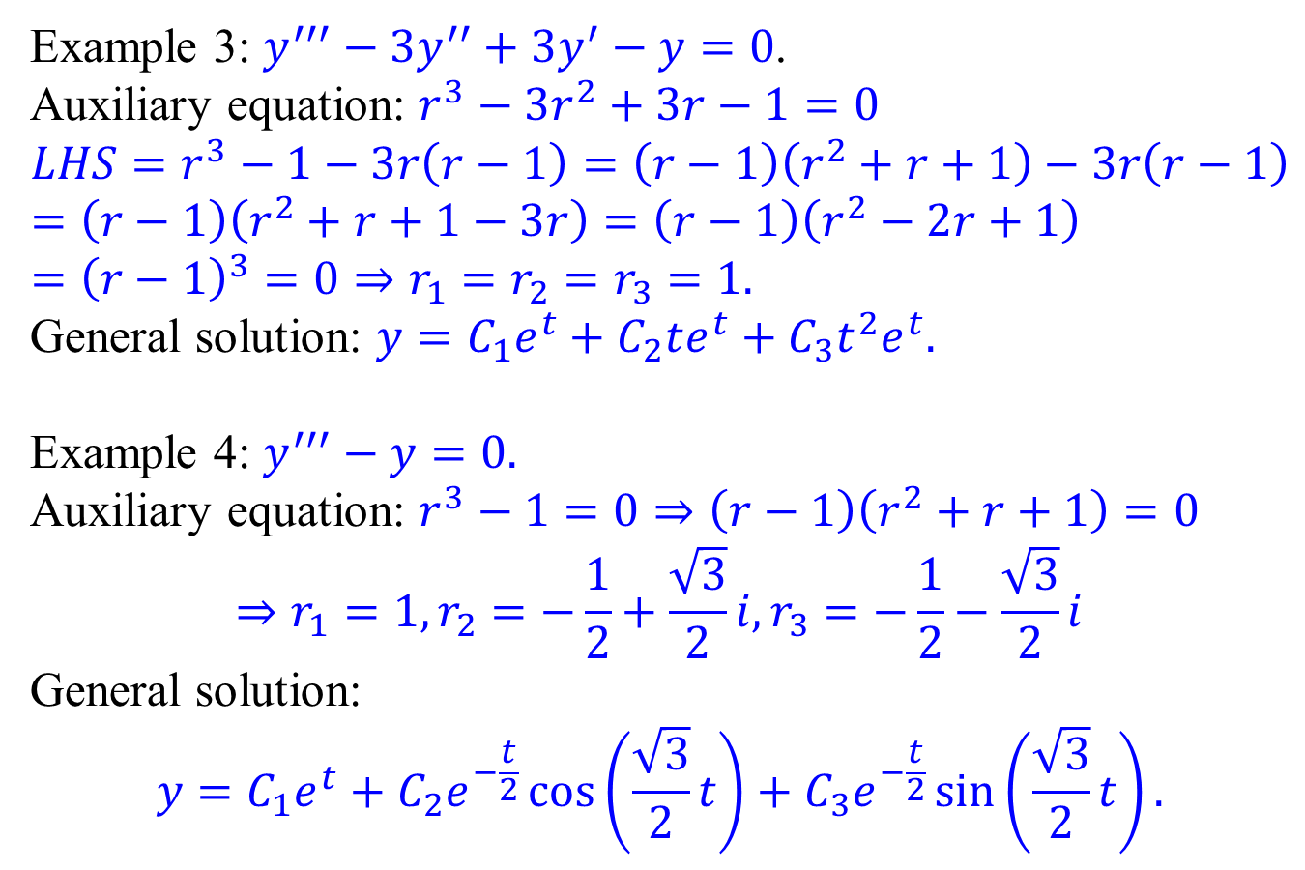
Examples:
Example 3: $y^{′′′}−3y^{′′}+3y^{′}−y=0$.
Auxiliary equation: $r^{3}−3r^{2}+3r−1=0$ $$LHS=r^{3}−1−3r\left(r−1\right)=\left(r−1\right)\left(r^{2}+r+1\right)−3r\left(r−1\right)=\left(r−1\right)\left(r^{2}+r+1−3r\right)=\left(r−1\right)\left(r^{2}−2r+1\right) \\ ={\left(r−1\right)}^{3}=0⇒r_{1}=r_{2}=r_{3}=1.$$
General solution: $y=C_{1}e^{t}+C_{2}te^{t}+C_{3}t^{2}e^{t}.$
Example 4: $y^{′′′}−y=0.$
Auxiliary equation: $r^{3}−1=0⇒\left(r−1\right)\left(r^{2}+r+1\right)=0$
$$⇒r_{1}=1,r_{2}=−\frac{1}{2}+\frac{\sqrt{3}}{2}i,r_{3}=−\frac{1}{2}−\frac{\sqrt{3}}{2}i$$
General solution: $$y=C_{1}e^{t}+C_{2}e^{−\frac{t}{2}}\cos\left(\frac{\sqrt{3}}{2}t\right)+C_{3}e^{−\frac{t}{2}}\sin\left(\frac{\sqrt{3}}{2}t\right).$$

Slide 9
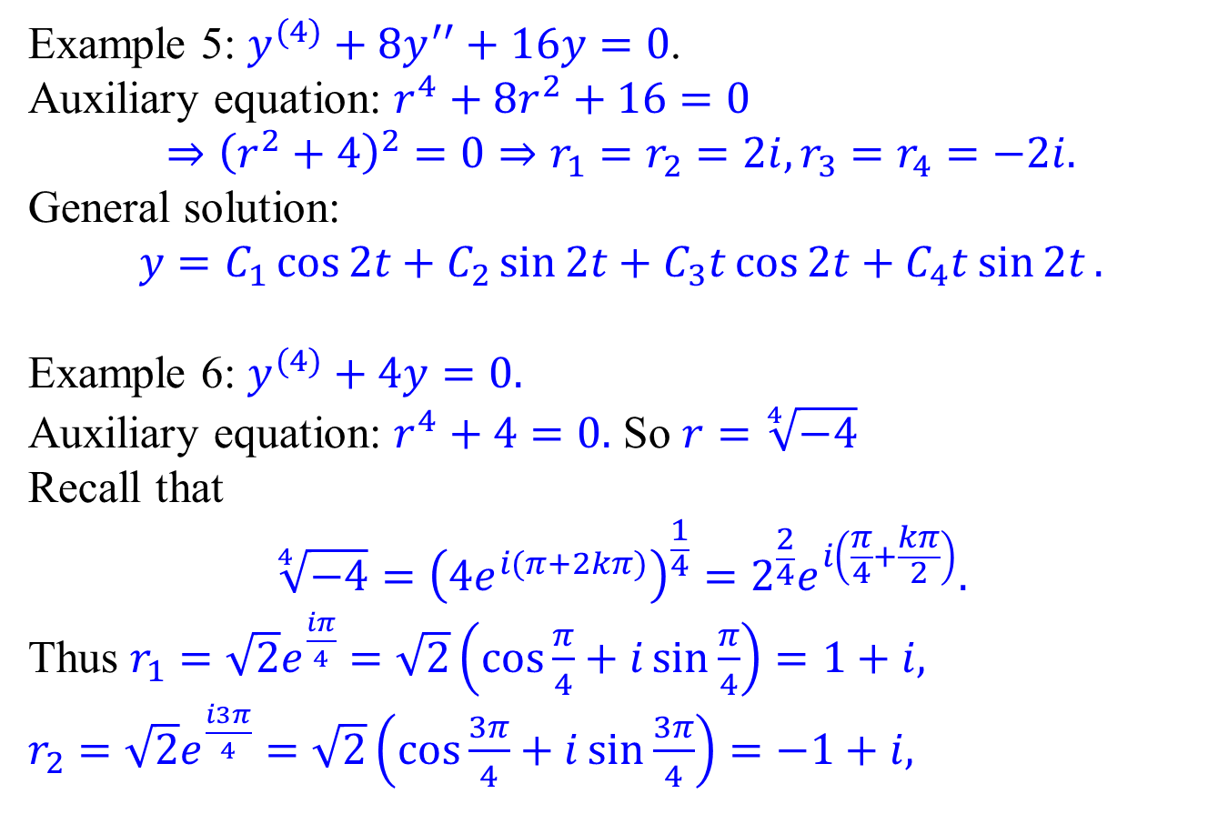
Examples:
Example 5: $y^{(4)}+8y^{′′}+16y=0$.
Auxiliary equation: $r^{4}+8r^{2}+16=0$ $$⇒{\left(r^{2}+4\right)}^{2}=0⇒r_{1}=r_{2}=2i,r_{3}=r_{4}=−2i.$$
General solution:
$$y=C_{1}\cos{2t}+C_{2}\sin{2t}+C_{3}t\cos{2t}+C_{4}t\sin{2t}.$$
Example 6: $y^{(4)}+4y=0.$
Auxiliary equation: $r^{4}+4=0.$ So $r=\sqrt[4]{−4}$
Recall that
$$\sqrt[4]{−4}={\left(4e^{i(π+2kπ)}\right)}^{\frac{1}{4}}=2^{\frac{2}{4}}e^{i\left(\frac{π}{4}+\frac{kπ}{2}\right)}.$$
Thus $r_{1}=\sqrt{2}e^{\frac{iπ}{4}}=\sqrt{2}\left(\cos{\frac{π}{4}}+i\sin{\frac{π}{4}}\right)=1+i,$
$r_{2}=\sqrt{2}e^{\frac{i3π}{4}}=\sqrt{2}\left(\cos{\frac{3π}{4}}+i\sin{\frac{3π}{4}}\right)=−1+i,$

Slide 10
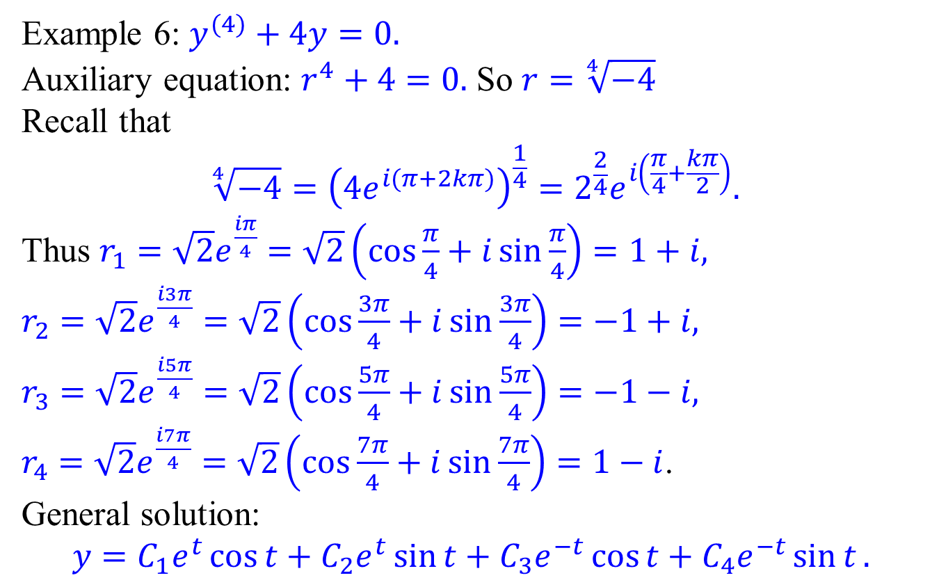
Examples:
Example 6: $y^{(4)}+4y=0.$
Auxiliary equation: $r^{4}+4=0.$ So $r=\sqrt[4]{−4}$
Recall that
$$\sqrt[4]{−4}={\left(4e^{i(π+2kπ)}\right)}^{\frac{1}{4}}=2^{\frac{2}{4}}e^{i\left(\frac{π}{4}+\frac{kπ}{2}\right)}.$$
Thus $r_{1}=\sqrt{2}e^{\frac{iπ}{4}}=\sqrt{2}\left(\cos{\frac{π}{4}}+i\sin{\frac{π}{4}}\right)=1+i,$
$r_{2}=\sqrt{2}e^{\frac{i3π}{4}}=\sqrt{2}\left(\cos{\frac{3π}{4}}+i\sin{\frac{3π}{4}}\right)=−1+i,$
$r_{3}=\sqrt{2}e^{\frac{i5π}{4}}=\sqrt{2}\left(\cos{\frac{5π}{4}}+i\sin{\frac{5π}{4}}\right)=−1−i,$ $r_{4}=\sqrt{2}e^{\frac{i7π}{4}}=\sqrt{2}\left(\cos{\frac{7π}{4}}+i\sin{\frac{7π}{4}}\right)=1−i$.
General solution:
$$y=C_{1}e^{t}\cos{t}+C_{2}e^{t}\sin{t}+C_{3}e^{−t}\cos{t}+C_{4}e^{−t}\sin{t}.$$

Slide 11
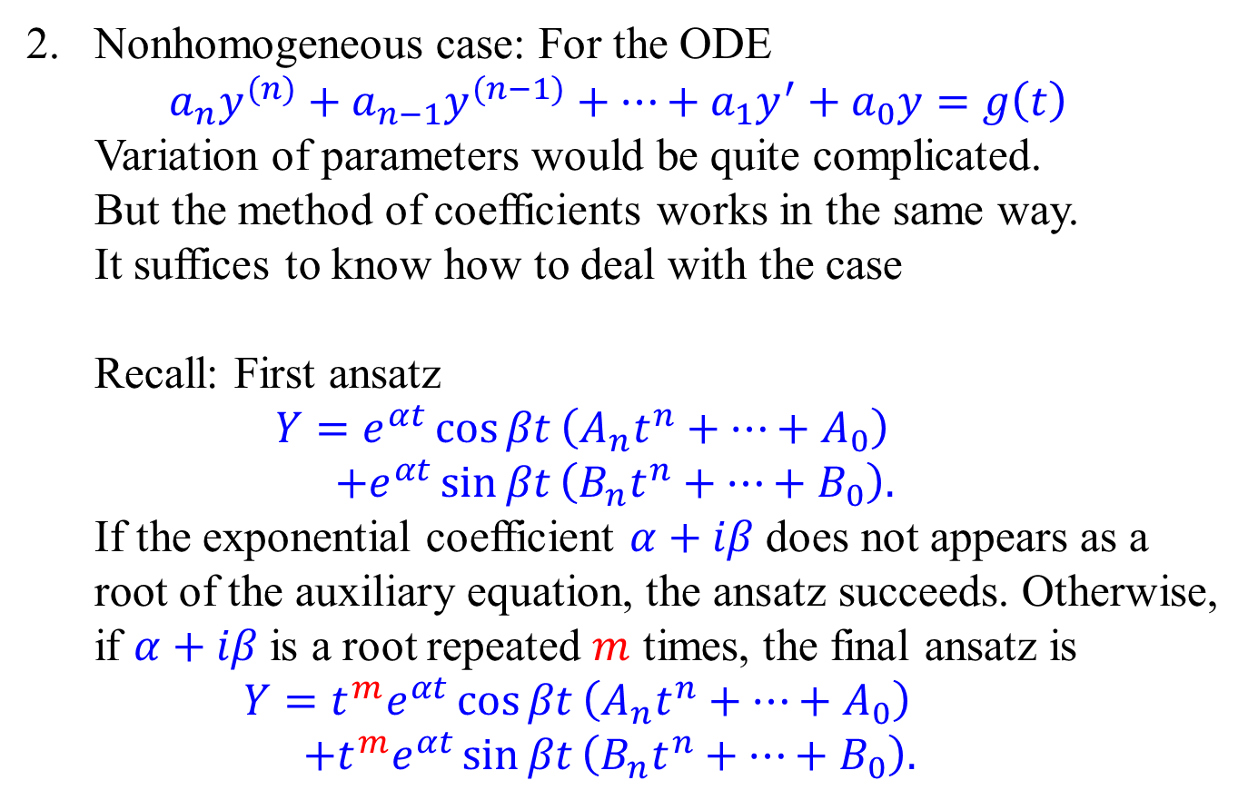
Higher order linear ODE with Const. Coeff.
Nonhomogeneous case: For the ODE $a_{n}y^{(n)}+a_{n−1}y^{(n−1)}+⋯+a_{1}y^{′}+a_{0}y=g\left(t\right)$
Variation of parameters would be quite complicated.
But the method of coefficients works in the same way.
It suffices to know how to deal with the case
Recall: First ansatz
$$Y=e^{αt}\cos{βt}\left(A_{n}t^{n}+⋯+A_{0}\right) \\ +e^{αt}\sin{βt}\left(B_{n}t^{n}+⋯+B_{0}\right).$$
If the exponential coefficient $α+iβ$ does not appears as a root of the auxiliary equation, the ansatz succeeds. Otherwise, if $α+iβ$ is a root repeated $m$ times, the final ansatz is
$$Y=t^{m}e^{αt}\cos{βt}\left(A_{n}t^{n}+⋯+A_{0}\right) \\ +t^{m}e^{αt}\sin{βt}\left(B_{n}t^{n}+⋯+B_{0}\right).$$
$$g\left(t\right)=e^{αt}\cos{βt}\left(polynomial\right)+e^{αt}\sin{βt}\left(polynomial\right),$$

Slide 12
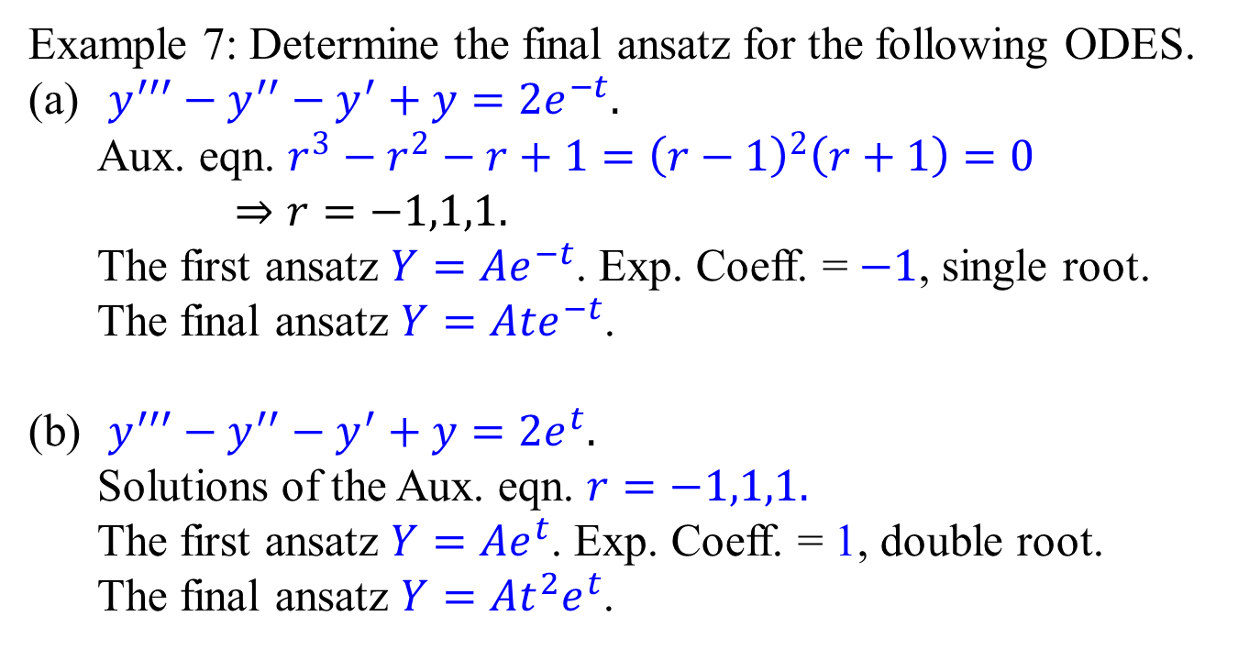
Examples:
Example 7: Determine the final ansatz for the following ODES.
$y^{′′′}−y^{′′}−y^{′}+y=2e^{−t}.$ Aux. eqn. $r^{3}−r^{2}−r+1={\left(r−1\right)}^{2}\left(r+1\right)=0$ $⇒r=−1,1,1.$ The first ansatz $Y=Ae^{−t}$. Exp. Coeff. = $−1$, single root. The final ansatz $Y=Ate^{−t}$.
$y^{′′′}−y^{′′}−y^{′}+y=2e^{t}.$ Solutions of the Aux. eqn. $r=−1,1,1.$ The first ansatz $Y=Ae^{t}$. Exp. Coeff. = 1, double root. The final ansatz $Y=At^{2}e^{t}$.

Slide 13
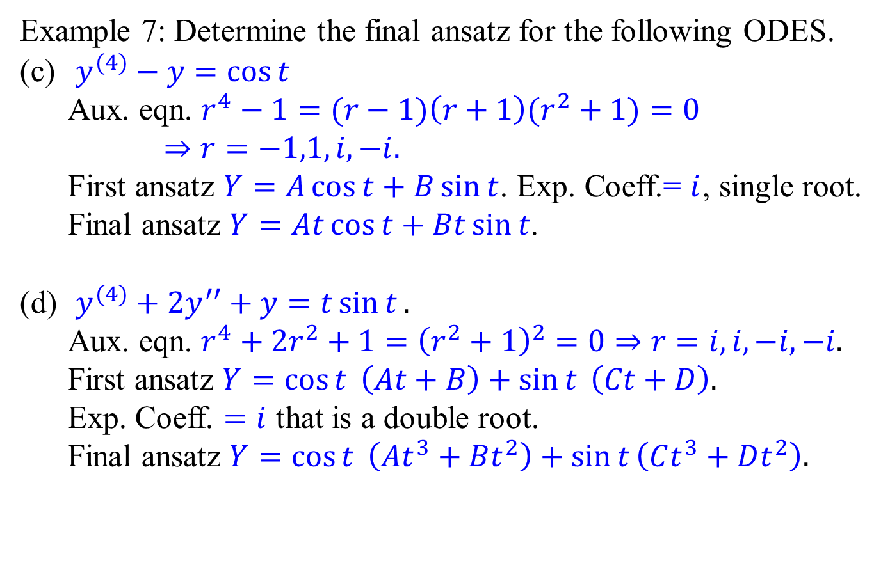
Examples:
Example 7: Determine the final ansatz for the following ODES.
$y^{(4)}−y=\cos{t}$ Aux. eqn. $r^{4}−1=(r−1)\left(r+1\right)(r^{2}+1)=0$ $⇒r=−1,1,i,−i.$ First ansatz $Y=A\cos{t}+B\sin{t}$. Exp. Coeff.= $i$, single root. Final ansatz $Y=At\cos{t}+Bt\sin{t}$.
$y^{(4)}+2y^{′′}+y=t\sin{t}.$ Aux. eqn. $r^{4}+2r^{2}+1={\left(r^{2}+1\right)}^{2}=0⇒r=i,i,−i,−i.$ First ansatz $Y=\cos{t} \left(At+B\right)+\sin{t} \left(Ct+D\right).$ Exp. Coeff. $=i$ that is a double root. Final ansatz $Y=\cos{t} \left(At^{3}+Bt^{2}\right)+\sin{t}\left(Ct^{3}+Dt^{2}\right).$

Slide 14
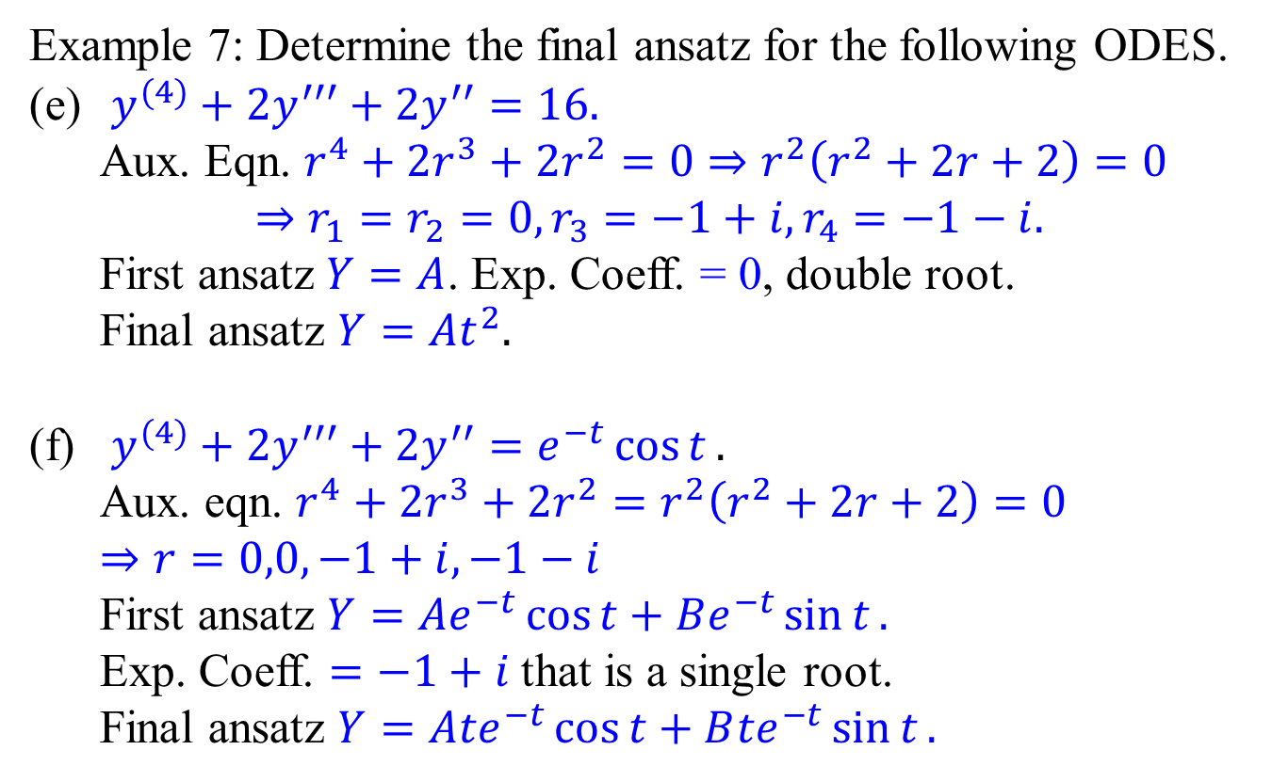
Examples:
Example 7: Determine the final ansatz for the following ODES.
$y^{(4)}+2y^{′′′}+2y^{′′}=16.$ Aux. Eqn. $r^{4}+2r^{3}+2r^{2}=0⇒r^{2}\left(r^{2}+2r+2\right)=0$ $⇒r_{1}=r_{2}=0,r_{3}=−1+i,r_{4}=−1−i.$ First ansatz $Y=A$. Exp. Coeff. = 0, double root. Final ansatz $Y=At^{2}.$
$y^{(4)}+2y^{′′′}+2y^{′′}=e^{−t}\cos{t}.$ Aux. eqn. $r^{4}+2r^{3}+2r^{2}=r^{2}\left(r^{2}+2r+2\right)=0$ $⇒r=0,0,−1+i,−1−i$ First ansatz $Y=Ae^{−t}\cos{t}+Be^{−t}\sin{t}.$ Exp. Coeff. $=−1+i$ that is a single root. Final ansatz $Y=A{te}^{−t}\cos{t}+B{te}^{−t}\sin{t}.$

Slide 15
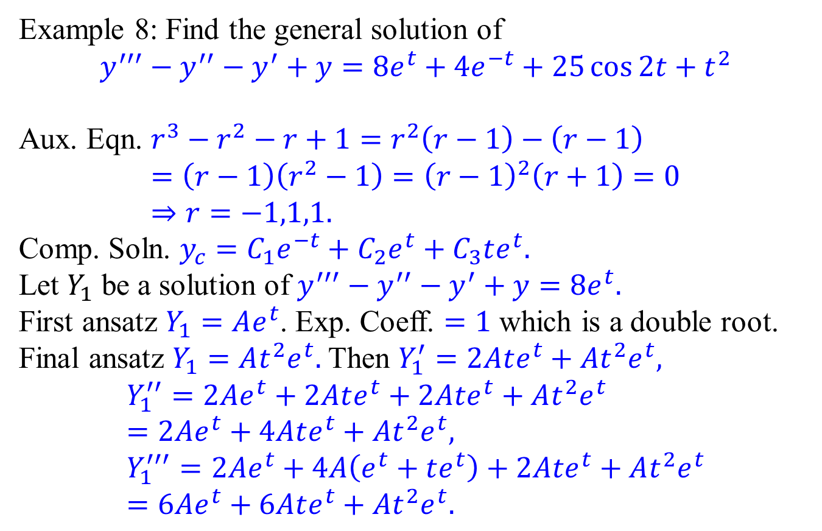
Concluding example
Example 8: Find the general solution of
$$y^{′′′}−y^{′′}−y^{′}+y=8e^{t}+4e^{−t}+25\cos{2t}+t^{2}$$
Aux. Eqn. $r^{3}−r^{2}−r+1=r^{2}\left(r−1\right)−\left(r−1\right)$ $$=\left(r−1\right)\left(r^{2}−1\right)={\left(r−1\right)}^{2}\left(r+1\right)=0 \\ ⇒r=−1,1,1.$$
Comp. Soln. $y_{c}=C_{1}e^{−t}+C_{2}e^{t}+C_{3}te^{t}.$
Let $Y_{1}$ be a solution of $y^{′′′}−y^{′′}−y^{′}+y=8e^{t}.$
First ansatz $Y_{1}=Ae^{t}$. Exp. Coeff. $=1$ which is a double root.
Final ansatz $Y_{1}=At^{2}e^{t}.$ Then $Y_{1}^{′}=2Ate^{t}+At^{2}e^{t},$
$$Y_{1}^{′′}=2Ae^{t}+2Ate^{t}+2Ate^{t}+At^{2}e^{t}=2Ae^{t}+4Ate^{t}+At^{2}e^{t}, \\ Y_{1}^{′′′}=2Ae^{t}+4A\left(e^{t}+te^{t}\right)+2Ate^{t}+At^{2}e^{t} \\ =6Ae^{t}+6Ate^{t}+At^{2}e^{t}.$$

Slide 16
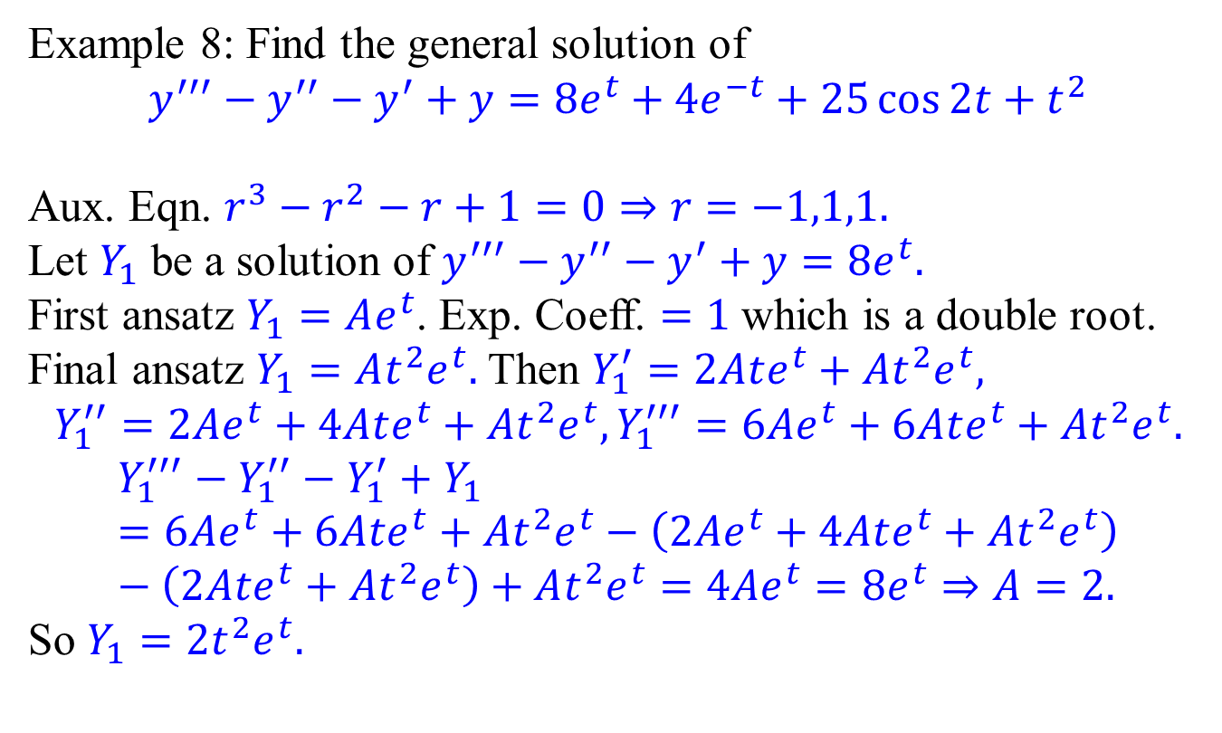
Concluding example
Example 8: Find the general solution of
$$y^{′′′}−y^{′′}−y^{′}+y=8e^{t}+4e^{−t}+25\cos{2t}+t^{2}$$
Aux. Eqn. $r^{3}−r^{2}−r+1=0⇒r=−1,1,1.$
Let $Y_{1}$ be a solution of $y^{′′′}−y^{′′}−y^{′}+y=8e^{t}.$
First ansatz $Y_{1}=Ae^{t}$. Exp. Coeff. $=1$ which is a double root.
Final ansatz $Y_{1}=At^{2}e^{t}.$ Then $Y_{1}^{′}=2Ate^{t}+At^{2}e^{t},$
$$Y_{1}^{′′}=2Ae^{t}+4Ate^{t}+At^{2}e^{t},Y_{1}^{′′′}=6Ae^{t}+6Ate^{t}+At^{2}e^{t}.$$
$$Y_{1}^{′′′}−Y_{1}^{′′}−Y_{1}^{′}+Y_{1}=6Ae^{t}+6Ate^{t}+At^{2}e^{t}−\left(2Ae^{t}+4Ate^{t}+At^{2}e^{t}\right)−\left(2Ate^{t}+At^{2}e^{t}\right)+At^{2}e^{t}=4Ae^{t}=8e^{t}⇒A=2.$$
So $Y_{1}=2t^{2}e^{t}.$

Slide 17
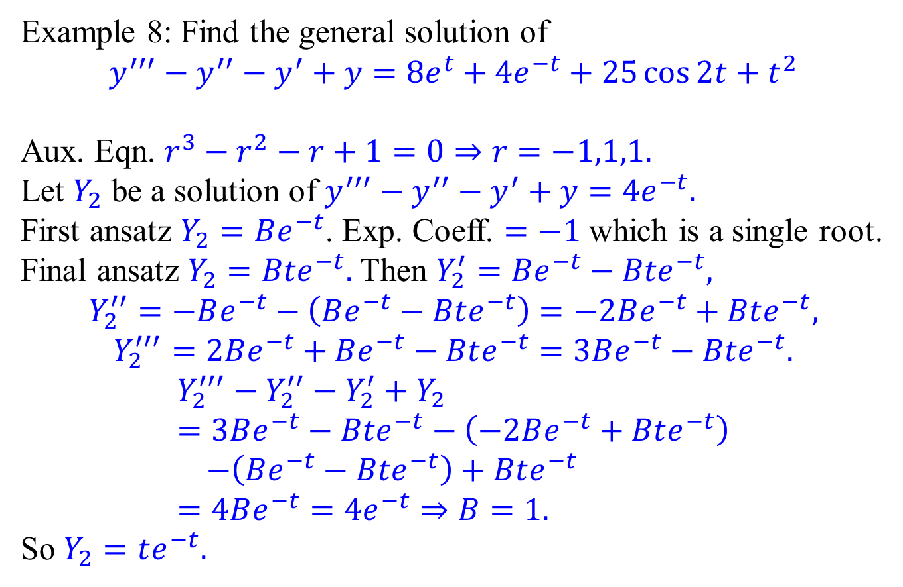
Concluding example
Example 8: Find the general solution of
$$y^{′′′}−y^{′′}−y^{′}+y=8e^{t}+4e^{−t}+25\cos{2t}+t^{2}$$
Aux. Eqn. $r^{3}−r^{2}−r+1=0⇒r=−1,1,1.$
Let $Y_{2}$ be a solution of $y^{′′′}−y^{′′}−y^{′}+y=4e^{−t}.$
First ansatz $Y_{2}=Be^{−t}$. Exp. Coeff. $=−1$ which is a single root.
Final ansatz $Y_{2}=Bte^{−t}.$ Then $Y_{2}^{′}=Be^{−t}−Bte^{−t},$
$$Y_{2}^{′′}=−Be^{−t}−\left(Be^{−t}−Bte^{−t}\right)=−2Be^{−t}+Bte^{−t},$$
$$Y_{2}^{′′′}=2Be^{−t}+Be^{−t}−Bte^{−t}=3Be^{−t}−Bte^{−t}.$$
$$Y_{2}^{′′′}−Y_{2}^{′′}−Y_{2}^{′}+Y_{2} \\ =3Be^{−t}−Bte^{−t}−\left(−2Be^{−t}+Bte^{−t}\right) \\ −\left(Be^{−t}−Bte^{−t}\right)+Bte^{−t} \\ =4Be^{−t}=4e^{−t}⇒B=1.$$
So $Y_{2}=te^{−t}.$

Slide 18
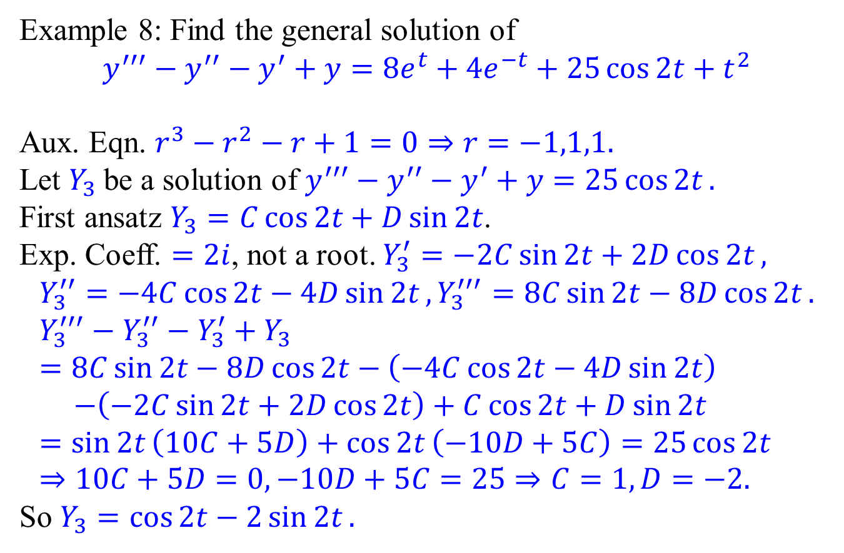
Concluding example
Example 8: Find the general solution of
$$y^{′′′}−y^{′′}−y^{′}+y=8e^{t}+4e^{−t}+25\cos{2t}+t^{2}$$
Aux. Eqn. $r^{3}−r^{2}−r+1=0⇒r=−1,1,1.$
Let $Y_{3}$ be a solution of $y^{′′′}−y^{′′}−y^{′}+y=25\cos{2t}.$
First ansatz $Y_{3}=C\cos{2t}+D\sin{2t}$.
Exp. Coeff. $=2i$, not a root. $Y_{3}^{′}=−2C\sin{2t}+2D\cos{2t},$ $$Y_{3}^{′′}=−4C\cos{2t}−4D\sin{2t}, Y_{3}^{′′′}=8C\sin{2t}−8D\cos{2t}. \\ Y_{3}^{′′′}−Y_{3}^{′′}−Y_{3}^{′}+Y_{3} \\ =8C\sin{2t}−8D\cos{2t}−\left(−4C\cos{2t}−4D\sin{2t}\right) \\ −\left(−2C\sin{2t}+2D\cos{2t}\right)+C\cos{2t}+D\sin{2t} \\ =\sin{2t}\left(10C+5D\right)+\cos{2t}\left(−10D+5C\right)=25\cos{2t} \\ ⇒10C+5D=0,−10D+5C=25⇒C=1,D=−2.$$ So $Y_{3}=\cos{2t}−2\sin{2t}.$

Slide 19
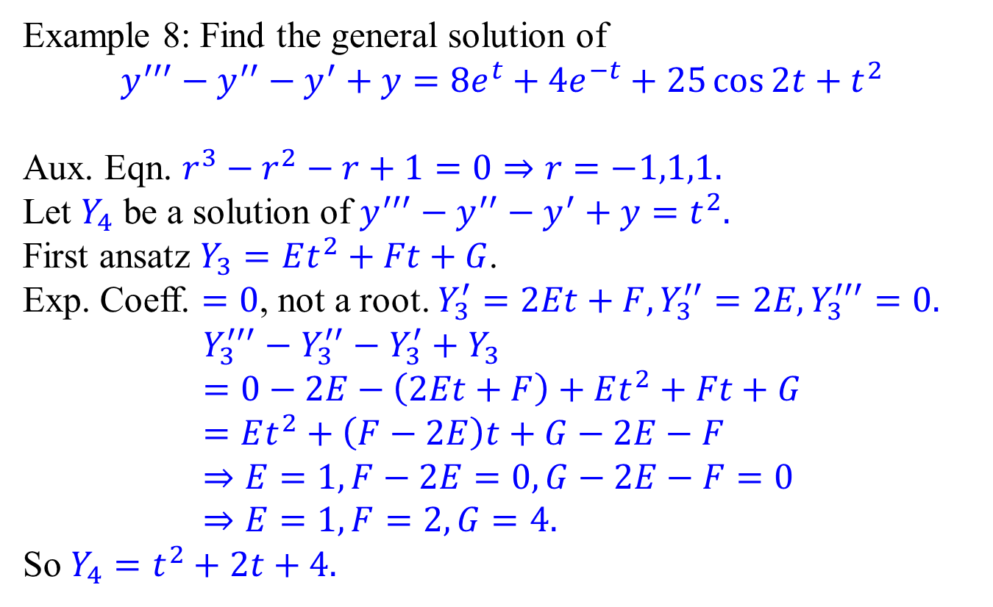
Concluding example
Example 8: Find the general solution of
$$y^{′′′}−y^{′′}−y^{′}+y=8e^{t}+4e^{−t}+25\cos{2t}+t^{2}$$
Aux. Eqn. $r^{3}−r^{2}−r+1=0⇒r=−1,1,1.$
Let $Y_{4}$ be a solution of $y^{′′′}−y^{′′}−y^{′}+y=t^{2}.$
First ansatz $Y_{3}=Et^{2}+Ft+G$.
Exp. Coeff. $=0$, not a root. $Y_{3}^{′}=2Et+F, Y_{3}^{′′}=2E, Y_{3}^{′′′}=0.$ $$Y_{3}^{′′′}−Y_{3}^{′′}−Y_{3}^{′}+Y_{3} \\ =0−2E−\left(2Et+F\right)+Et^{2}+Ft+G \\ =Et^{2}+\left(F−2E\right)t+G−2E−F \\ ⇒E=1,F−2E=0,G−2E−F=0 \\ ⇒E=1,F=2,G=4.$$ So $Y_{4}=t^{2}+2t+4.$

Slide 20
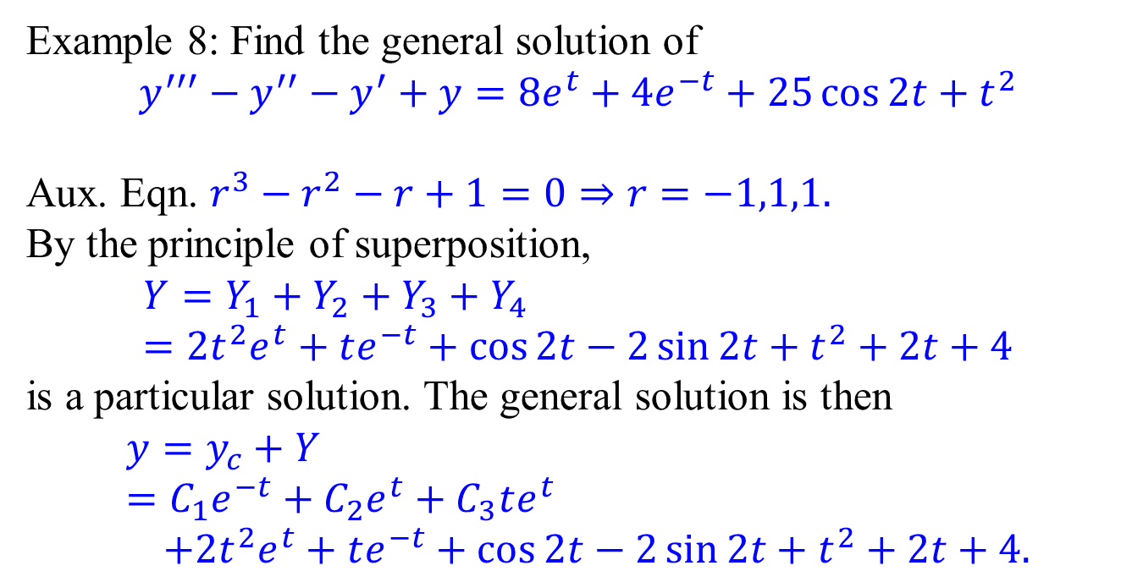
Concluding example
Example 8: Find the general solution of
$$y^{′′′}−y^{′′}−y^{′}+y=8e^{t}+4e^{−t}+25\cos{2t}+t^{2}$$
Aux. Eqn. $r^{3}−r^{2}−r+1=0⇒r=−1,1,1.$
By the principle of superposition,
$$Y=Y_{1}+Y_{2}+Y_{3}+Y_{4} \\ =2t^{2}e^{t}+te^{−t}+\cos{2t}−2\sin{2t}+t^{2}+2t+4$$
is a particular solution. The general solution is then
$$y=y_{c}+Y \\ =C_{1}e^{−t}+C_{2}e^{t}+C_{3}te^{t} \\ +2t^{2}e^{t}+te^{−t}+\cos{2t}−2\sin{2t}+t^{2}+2t+4.$$

